Slide 1
E- Commerce Database Management System
Presented By :
Dhruvi vaidhya
Vrunda Chauhan
Kirti Chauhan

Slide 2
Contents
Introduction
What is E-commerce
Advantages and Disadvantages of E-commerce
SQL Server
Database
Primary Key
Foreign Key
Diagram

Slide 3
INTRODUCTION
In this new modern era of online shopping no seller wants to be left behind and every seller want to the shift from offline selling model to an online selling model for a rampant growth.
Therefore, as an Data Analytics our job is to ease the path of this transition for the seller. Amongst many things that an online site requires the most important is a database system.
Hence in this project we are planning to design a database where small sellers can sell their product online.
The Prime Objective of our database project is to design a robust E-commerce database by performing operations such as
Viewing orders Updating database
Maintaining data Reviewing products
Placing orders consistency across tables

Slide 4
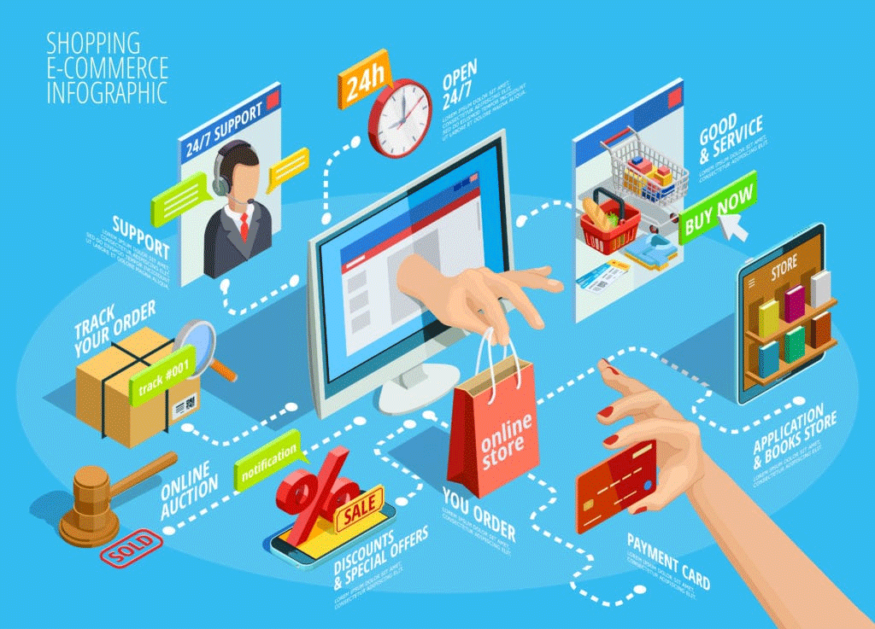
WHAT IS E-COMMERCE
Commonly known as Electronic Marketing.
E-Commerce or Electronic commerce is a process of buying, selling, transferring, or exchanging products, services, and/or information via electronic networks and computers.
Use of E-Commerce :
Low Entry Cost
Reduces Transaction Costs
Access To The Global Market
Secure Market Share

Slide 5
E-Commerce:
Advantage :
Order can be placed from anywhere at any time.
Eliminates the operating cost.
It helps in connecting with people all across the world.
Retargets the customers.
There is always detailed product information offered.
Disadvantage :
There is no guarantee for the quality of products.
Lack of personal touch.
It doesn’t give the luxury of trying before buying the item.
Long delivery period.
There is always a concern with security issues.

Slide 6
SQL Server
SQL Server is a database server by Microsoft. The Microsoft relational database management system is a software product which primarily stores and retrieves data requested by other applications. These applications may run on the same or a different computer.
Database
Databases are used for storing, maintaining and accessing any sort of data. They collect information on people, places or things. That information is gathered in one place so that it can be observed and analyzed. Databases can be thought of as an organized collection of information.

Slide 7
Primary Key : Primary Key is Unique Key. Primary Key can not allow null value Access only one Primary Key in a one table.
Foreign Key : Foreign Key is a reference by Primary Key and Foreign Key can apply more than time in table.

Slide 8
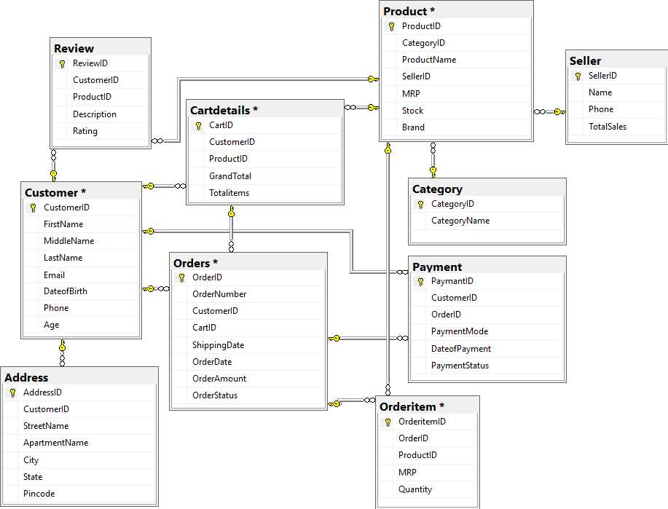
Diagram:

